Slide 1
Name | James
Git Hash | 387250d9ce0d7fa4ac12a5086a510e7ff32f32bf
Sprint number | Start date | end date | Work hard rating
5 | 13/6/2022 | 24/6/2022 | 4/5

Slide 2
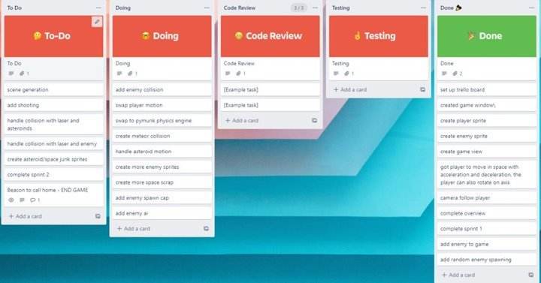
KANBAN board at the start of the sprint

Slide 3
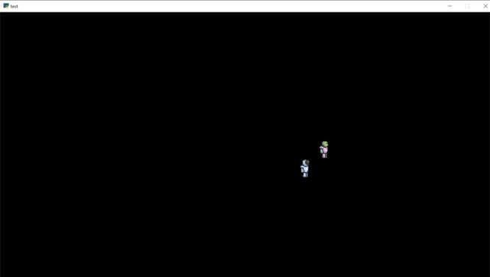
Screenshot of the game at the start of the sprint

Slide 4
Sprint Reflection and summary
I think i did a good amount of work for this sprint and were alot quicker than earlier ones. I was able to add a bullet that collided with the enemy and pushed them away and i also made a mining laser to mine asteroids i wasn't able to get it to mine asteroids in time for the end of the sprint however every other aspect of it does work and it will be easy to get it to mine them.These 2 additions to the game are essential for it to develop into its intended role. Overall no other problems occurred on the way and i was able to get an important aspect of the game done making it function as intended.

Slide 5
Briefly describe other team members contributions
Cam was able to finish the mechanics of the enemies controls and implement them into the main game, there were also put into the physics engine meaning that is also complete. This enabled the enemy to seek and follow the player whilst avoiding other enemies and asteroids within it's path. This enabled the game to gain take a huge step in progress.
Overall he did a good job in this sprint and allowed the game to develop further making the completion of the enemy controls an important step for the game.

Slide 6
Major Changes and Achievements Described
Added a mining laser to the game which can be used by the player by pressing 2 and then clicking the mouse, it has a range of around 200 pixels and when contact is made with an asteroid a contact sprite is put on the end of the laser and then is prohibited to go any further.
Added a bullet to the game which is accessed by the player by pressing 1 and then clicking the mouse firing a single bullet in the direction the curser is at. On impact with an enemy, it will catapult them away same with if contact with an asteroid is made.
Added and finished enemy controls and mechanics. Enemy is able to seek out player whilst avoiding other enemies and asteroids in its path by changing its trajectory on the go.
Overall, these changes enabled the game to grow and developed getting it closer to its finished state.

Slide 7
Brief Description of your testing
Tested the mining laser by firing it at an asteroid and found that it did make contact making a contact sprite and the length of the laser did not extend beyond the asteroid it contacted showing that it is working passing testing.
Tested bullet by firing it at an enemy, found that it pushed them away to a considerable distance, it also disappeared upon impact with object saving computational power showing that the bullet works and functions passing testing.
Since the mechanics of the enemy has been tested as it was built we just need to see whether it transitioned ok into the game and we found that it did and it function as intended passing testing.

Slide 8
Link to testing results/tables

Slide 9
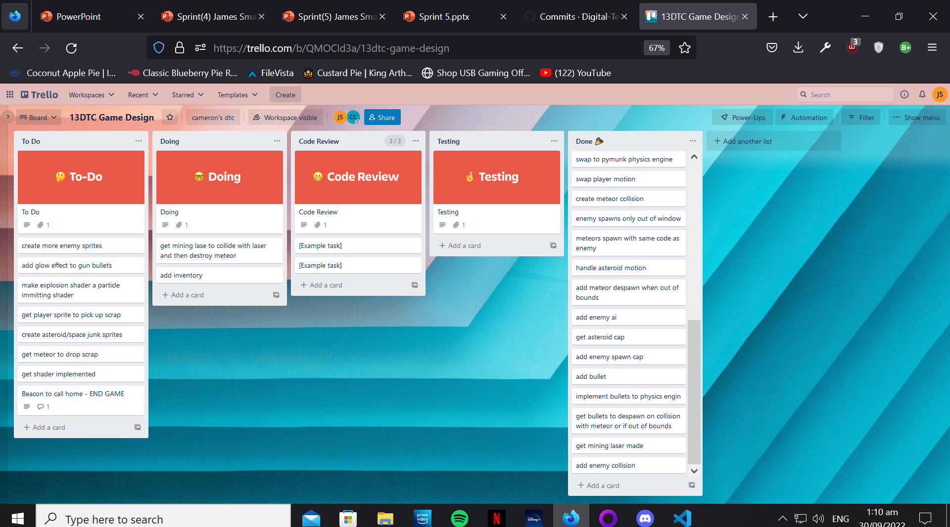
KANBAN board at the end of the sprint

Slide 10
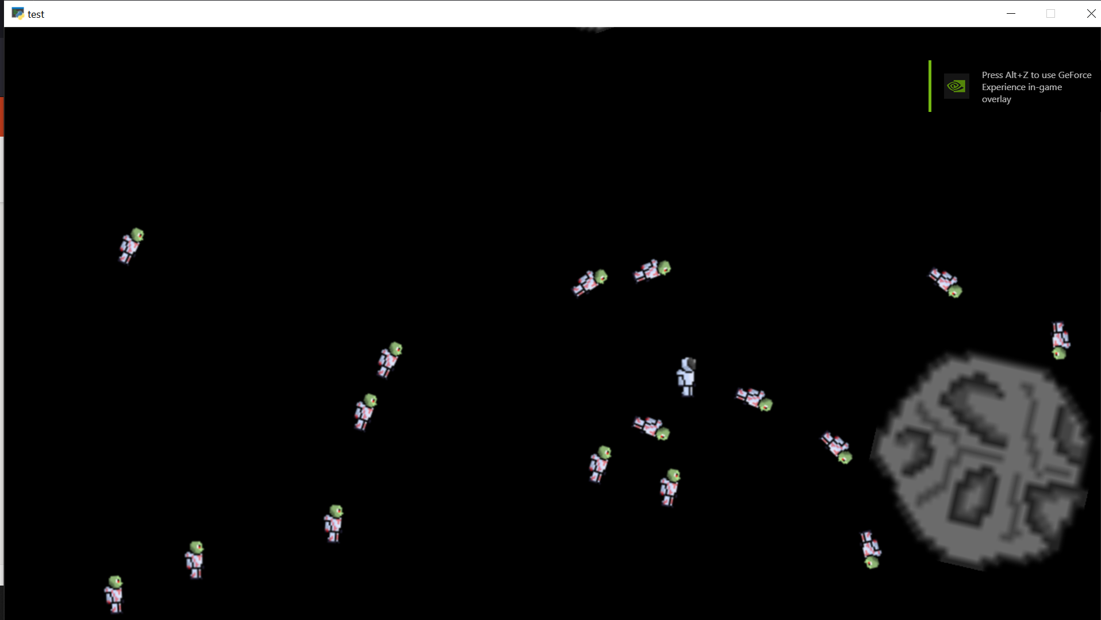
Screenshot of the game at the end of the sprint

Slide 11
Notes for next time, future improvements
Overall i think i did a good job on this sprint and so did cameron, we were able to successfully add enemies to the game with a bullet and a mining laser making huge strides in the development of the game. There's is still a lot for us to do we have to add the ability to kill the enemy and for them to kill us, Aswell as giving the player the ability to mine the asteroids and to be able to win the game. I would like to improve my involvement in the side of creating assets and the possibility of me creating a shader for the death of the enemies via an explosion.

Slide 12
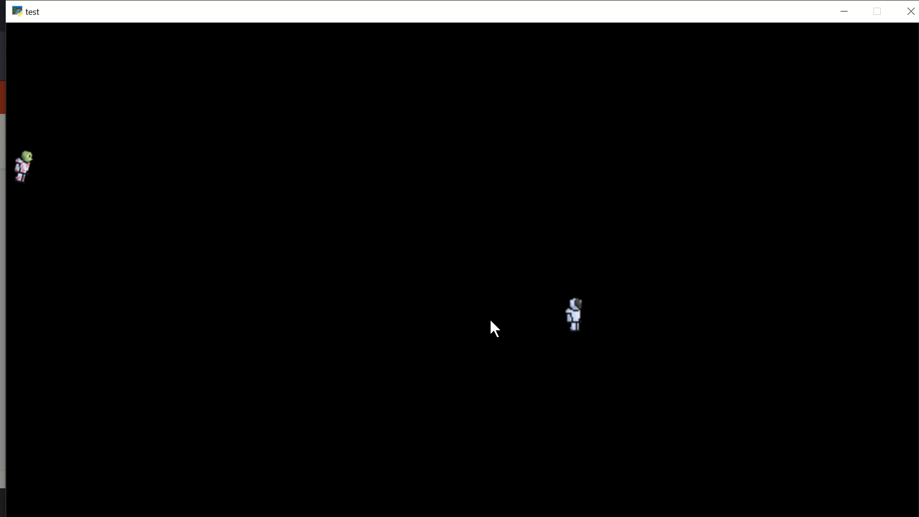
Video of the game at the end of the sprint

